Slide 1
PatternMetric documentation
ProcessesJunctionsRelsMetric() (process sequence and abstraction)
EventsProcessesRelsMetric (Event triggers process)
ActorsRolesRelsMetric (actor and role assignment)
BetweenFacilitiesRelsMetric (Facility relations)
EquipmentFacilitiesRelsMetric (equipment assigned to facility)
BetweenDistributionNetworksRelsMetric (Distribution Networks)
FacilitiesProcessesRelsMetric (Material Flow)
JunctionsRelsTypeMetric (Misconnected Junctions)
CrossLayerAssociationMetric (use of association relations)
Note about Specialization Rule (applicable to all 9 metrics)
Metric
Metric

Slide 2
ProcessesJunctionsRelsMetric- Detailed description
Business processes can be related via trigger, composition or aggregation relationship
Application processes can be related via trigger, composition or aggregation relationship
Technology processes can be related via trigger, composition or aggregation relationship
If processes are related via trigger, there can be and-junctions/or-junctions in-between

Slide 3
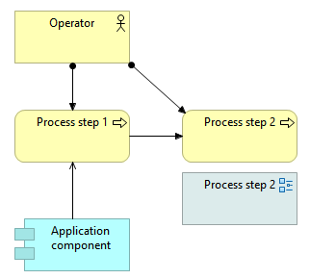
ProcessesJunctionsRelsMetric- Guidelines Connection 1/3
This metric is based on [Pattern Architecture model guidelines
- Processes] (slides day1part2 - pg.31):
Processes are constructed using trigger
relations

Slide 4
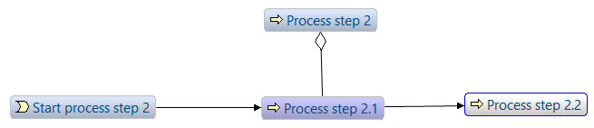
ProcessesJunctionsRelsMetric- Guidelines Connection 2/3
This metric is based on [Pattern Architecture model guidelines
- nested processes] (slides day1part2 - pg.32):
Process steps in the sub process structure are connected via specific relationships to the main process step

Slide 5
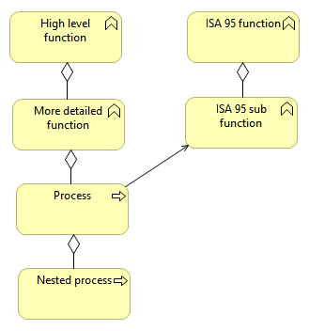
ProcessesJunctionsRelsMetric- Guidelines Connection 3/3
This metric is based on [Pattern Architecture model guidelines - Hierarchies] (slides day1part2 - pg.34):
Organize processes – potentially along multiple dimensions
Use processes for more detailed and executable processes (composition/aggregation relationship)

Slide 6
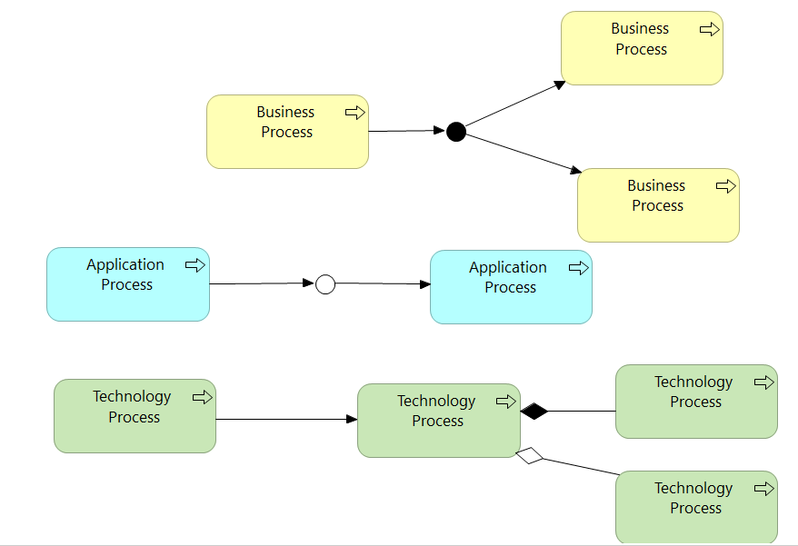
ProcessesJunctionsRelsMetric- Valid examples

Slide 7
EventsProcessesRelsMetric- Detailed description
Business events and Business Processes can be related via trigger relationship
Application events and Application Processes can be related via trigger relationship
Technology events and Technology Processes can be related via trigger relationship
If processes are related to events via trigger, there can be and-junctions/or-junctions in-between

Slide 8
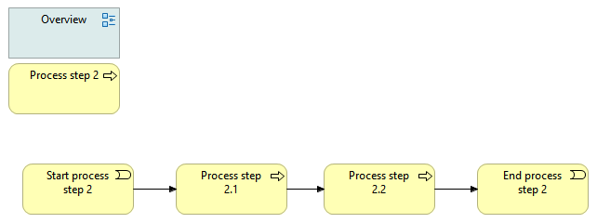
EventsProcessesRelsMetric- Guidelines Connection 1/1
This metric is based on [Pattern Architecture model guidelines
- nested processes] (slides day1part2 - pg.31):
A nested process has always a start and end event

Slide 9
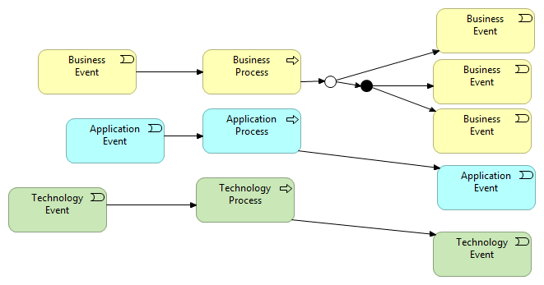
EventsProcessesRelsMetric- Valid examples

Slide 10
ActorsRolesRelsMetric- Detailed description
Business Actors and Business Roles can be related via assignment relationships
Business Actors and Business Processes can be related via assignment relationships
Business Roles and Business Processes can be related via assignment relationships
Business Actors and Business Functions can be related via assignment relationships
Business Roles and Business Functions can be related via assignment relationships

Slide 11
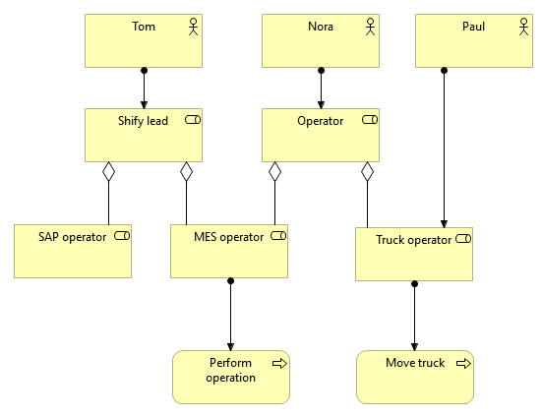
ActorsRolesRelsMetric- Guidelines Connection 1/1
This metric is based on [Pattern Architecture model guidelines
- Roles and Actors] (slides day1part2 - pg.35):
Separation of functions (roles)
and actors in an organization
Explicate different roles

Slide 12
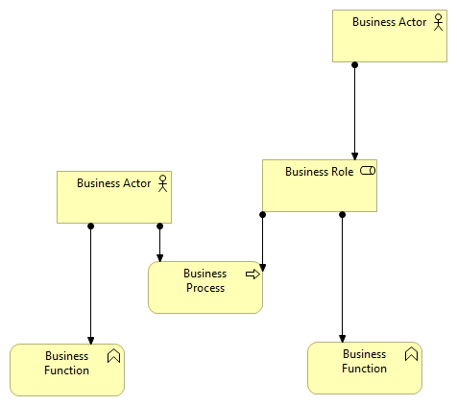
ActorsRolesRelsMetric- Valid examples

Slide 13
BetweenFacilitiesRelsMetric- Detailed description
Facilities can be related via aggregation, composition or realization relationships

Slide 14
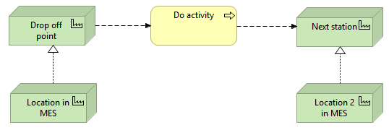
BetweenFacilitiesRelsMetric- Guidelines Connection 1/1
This metric is based on [Pattern Architecture model guidelines
- Material Flow] (slides day1part2 - pg.36):
Differentiate physical locations from locations in systems

Slide 15
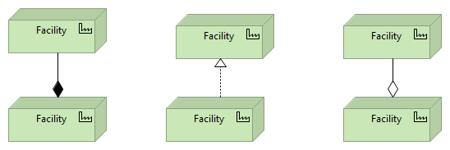
BetweenFacilitiesRelsMetric- Valid examples

Slide 16
EquipmentFacilitiesRelsMetric- Detailed description
Equipment and Facilities can be related via assignment relationships

Slide 17
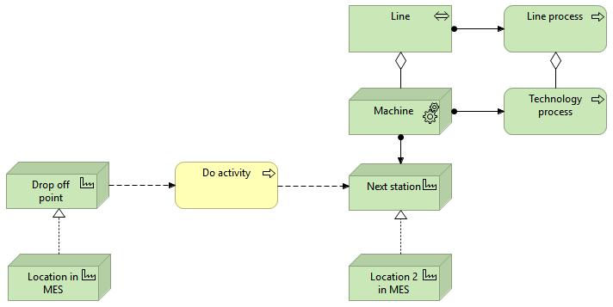
EquipmentFacilitiesRelsMetric- Guidelines Connection 1/1
This metric is based on [Pattern Architecture model guidelines
- Material Flow] (slides day1part2 - pg.37):

Slide 18
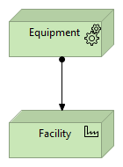
EquipmentFacilitiesRelsMetric- Valid examples

Slide 19
BetweenDistributionNetworksRelsMetric- Detailed description
Distribution Networks can be related via aggregation, composition, trigger or flow relationship
If Distribution Networks are related via trigger, there can be and-junctions/or-junctions in-between
If Distribution Networks are related via flow, there can be and-junctions/or-junctions in-between

Slide 20
BetweenDistributionNetworksRelsMetric- Guidelines Connection 1/1
This metric is based on [X](X): No reference to Distribution Networks in the Model Guidelines as of 15-Jan-2020

Slide 21
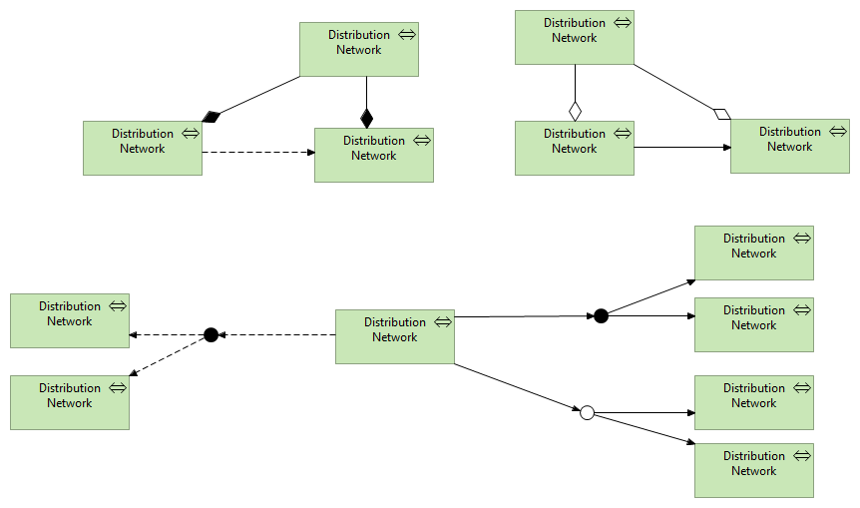
BetweenDistributionNetworksRelsMetric- Valid examples

Slide 22
FacilitiesProcessesRelsMetric- Detailed description
Facilities and Business Processes can not be related via trigger relationships
Facilities and Application Processes can not be related via trigger relationships
Facilities and Technology Processes can not be related via trigger relationships
If Facilities and Processes are related, there may be and-junctions/or-junctions in-between to form a path. Trigger relationships can not be part of this path.

Slide 23
FacilitiesProcessesRelsMetric- Guidelines Connection 1/1
This metric is based on [Pattern Architecture model guidelines
- Material Flow] (slides day1part2 - pg.36):
In push processes material flow triggers processes by having material at some specific location

Slide 24
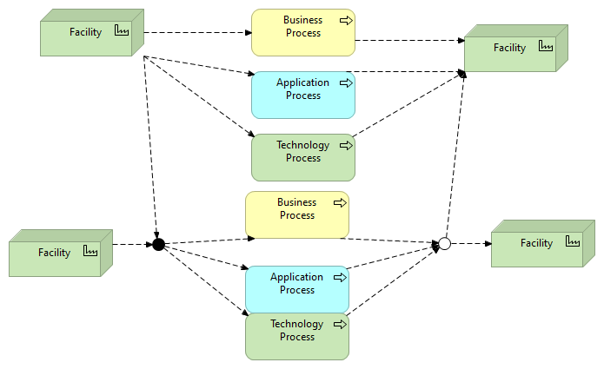
FacilitiesProcessesRelsMetric- Valid examples

Slide 25
JunctionsRelsTypeMetric- Detailed description
All relationships connected to And-Junctions/Or-Junctions must be of one relationshiptype only
All And-Junctions/Or-Junctions must have at least one outgoing relationship
All And-Junctions/Or-Junctions must have at least one incoming relationship

Slide 26
JunctionsRelsTypeMetric- Guidelines Connection 1/1
This metric is based on [X](X): No reference to Junctions in the Model Guidelines as of 26-Jan-2020

Slide 27
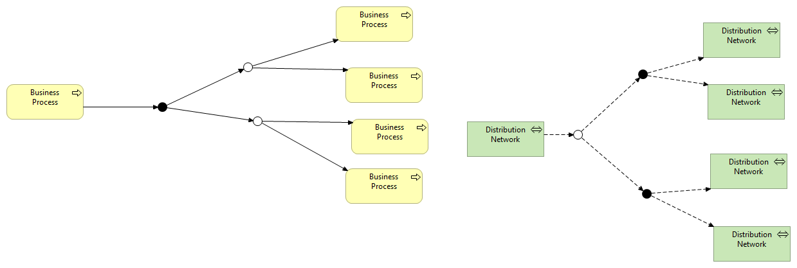
JunctionsRelsTypeMetric- Valid examples

Slide 28
CrossLayerAssociationMetric- Detailed description 1/2
Concepts in the business layer, application layer, technology layer, physical layer, or junctions cannot be related to other concepts in the business layer, application layer, technology layer, physical layer, or junctions via association
Concepts in the business layer are Business actor, Business Role, Business Collaboration, Business Interface, Business Process, Business Function, Business Interaction, Business Event, Business Service, Business Object, Contract, Representation and Product
Concepts in the application layer are Application Component, Application Collaboration, Application Interface, Application Function, Application Interaction, Application Process, Application Event, Application Service and Data Object

Slide 29
CrossLayerAssociationMetric- Detailed description 2/2
Concepts in the technology layer are Node, Device, System Software, Technology Collaboration, Technology Interface, Path, Communication network, Technology Function, Technology Process, Technology Interaction, Technology Event, Technology Service and Artifact
Concepts in the physical layer are Equipment, Facility, Distribution Network and Material
Junctions are And-Junctions/Or-Junctions

Slide 30
CrossLayerAssociationMetricMetric- Guidelines Connection 1/1
This metric is based on [X](X): No reference to Associations in the Model Guidelines as of 26-Jan-2020

Slide 31
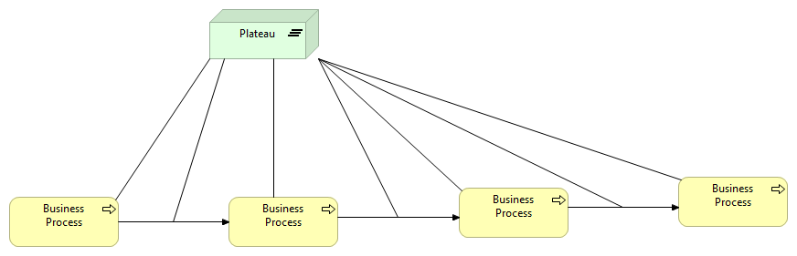
CrossLayerAssociationMetric- Valid examples

Slide 32
Specialization rule- Detailed description 1/1
This rule applies to the preceding 9 PatternMetrics
All relationships between similar-type nodes can be of type specialization
The three metrics ProcessesJunctionsRelsMetric (relations between processes), BetweenFacilitiesRelsMetric and BetweenDistributionNetworksRelsMetric implement the specialization rule

Slide 33
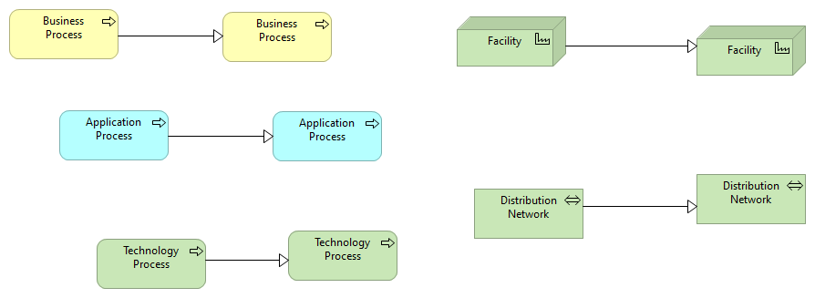
Specialization rule- Valid examples

